Slide 1

Canadian Labor Force Data Visualization
DS8007 FINAL PRESENTATION
KSHIRABDHI PATEL

Slide 2
Introduction
Canadian labor force participation has been increasing as more and more immigrants and students are choosing Canada as their home
A detailed understanding of the occupational information is beneficial for everyone to start with a better career opportunity
The National Occupational Classification (NOC) provides a systematic classification structure of occupational activity in Canada
However, the information is in textual format and not easily interpretable
This project involves visualization techniques to interpret the information in a simpler way

Slide 3
The Data
Data Source: Statistics Canada
https://www12.statcan.gc.ca/census-recensement/2016/dp-pd/dv-vd/occ-pro/occ-pro-tab-eng.cfm
Dataset: Employed labor force who worked full year, full time and reported employment income in 2015, 2016 Census:
https://www12.statcan.gc.ca/census-recensement/2016/dp-pd/dv-vd/occ-pro/download-telecharger/GetFile.cfm?LANG=E&TYPE=CSV

Slide 4
The Data
The data is distributed as per the following occupational hierarchy:
10 broad occupational categories
39 major groups
138 minor groups
495 Unit Groups

Slide 5
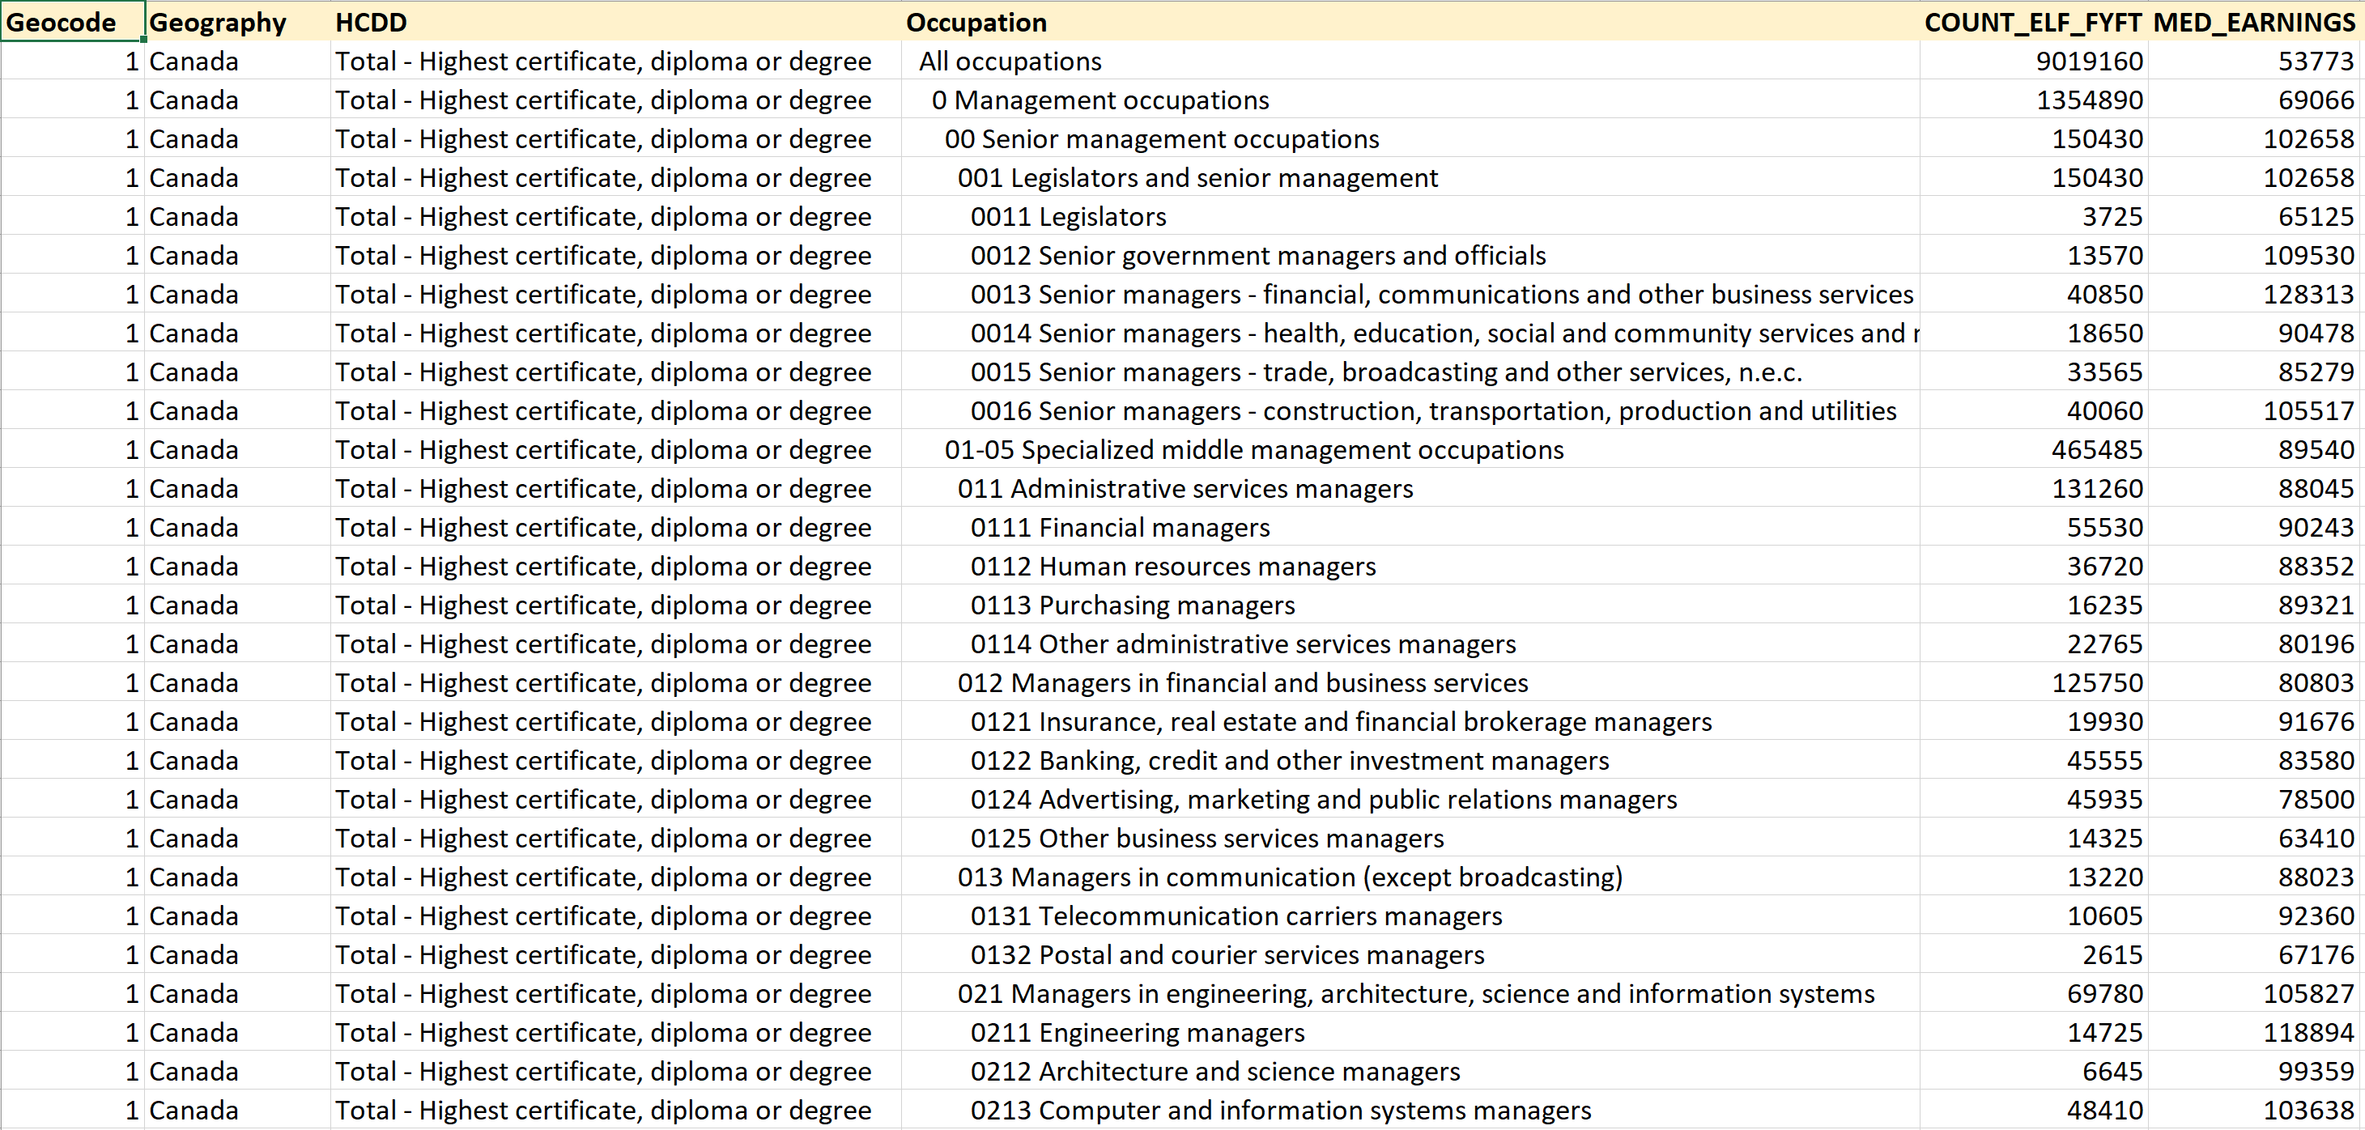
The Data
Sample of data file:

Slide 6
Tools Used
Data Cleaning: NumPy, Pandas, SciPy, Re
Graph, Charts and Geospatial Visualization: Matplotlib, Seaborn, Plotly, Geoplotlib, Geopandas

Slide 7
Visualizing Canadian Labor Force Data

Slide 8
Questions to be Answered
Distribution of employment income of the employed labor force
Proportion of each occupation category to the total job market
Distribution of jobs by Canadian provinces and cities
Classification of Job types by education and skill levels

Slide 9
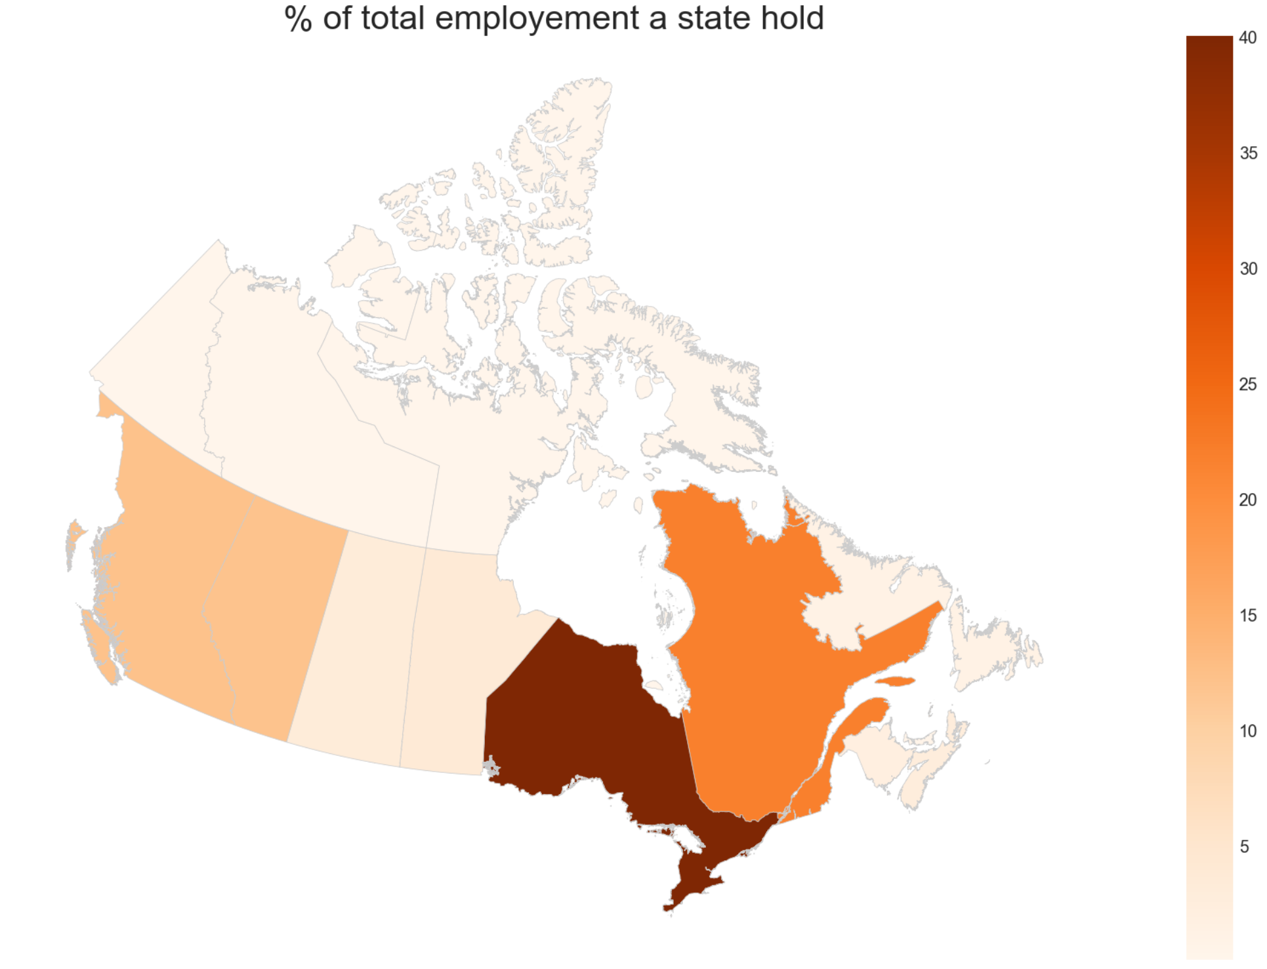
How jobs are distributed across Canada?
Ontario creates 40% of total employment in Canada
2nd - Quebec
3rd – British Columbia

Slide 10
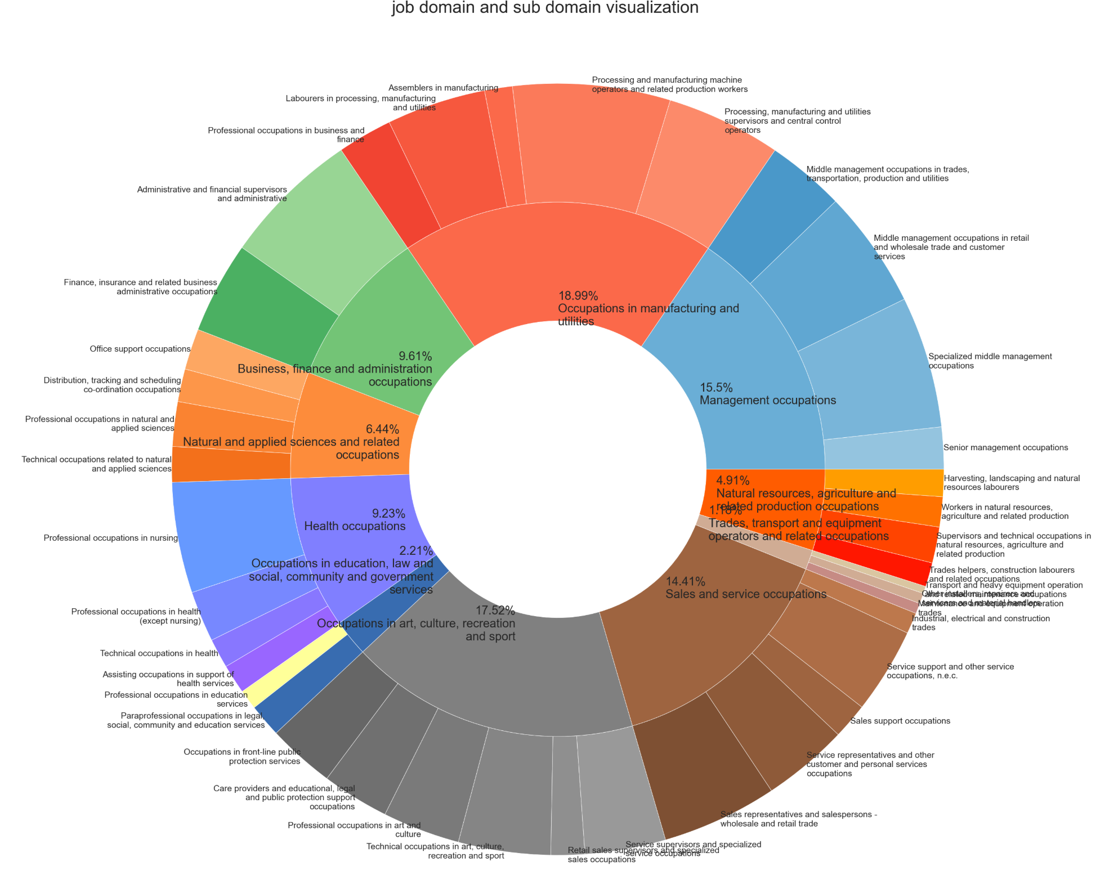
Job Hierarchy Visualization
10 broad occupational categories
39 major groups

Slide 11
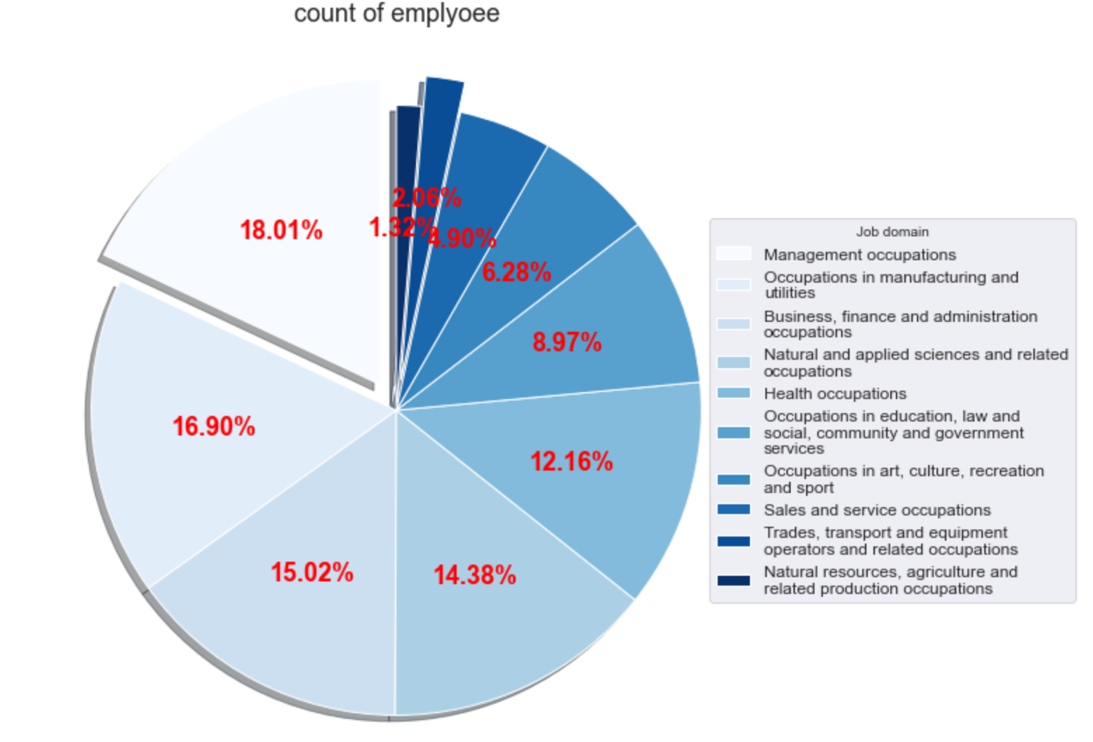
Market share of Job Occupations
Management Occupation has the maximum job market share
2nd – Manufacturing Industry
3rd – Business and Finance
Least – Natural Resources and Agriculture

Slide 12
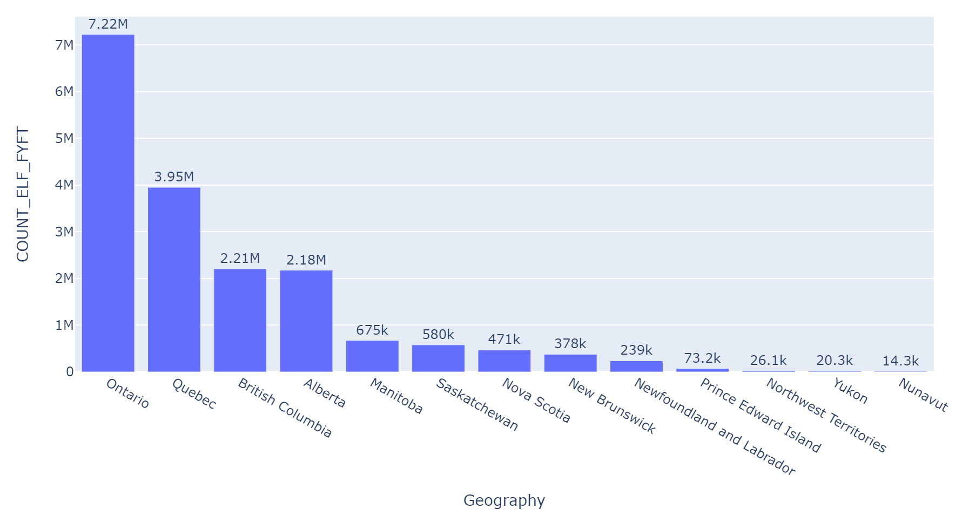
Employment Distribution across Provinces
1st – Ontario (7.22M)
2nd – Quebec (3.95M)
3rd – British Columbia (2.21M)

Slide 13
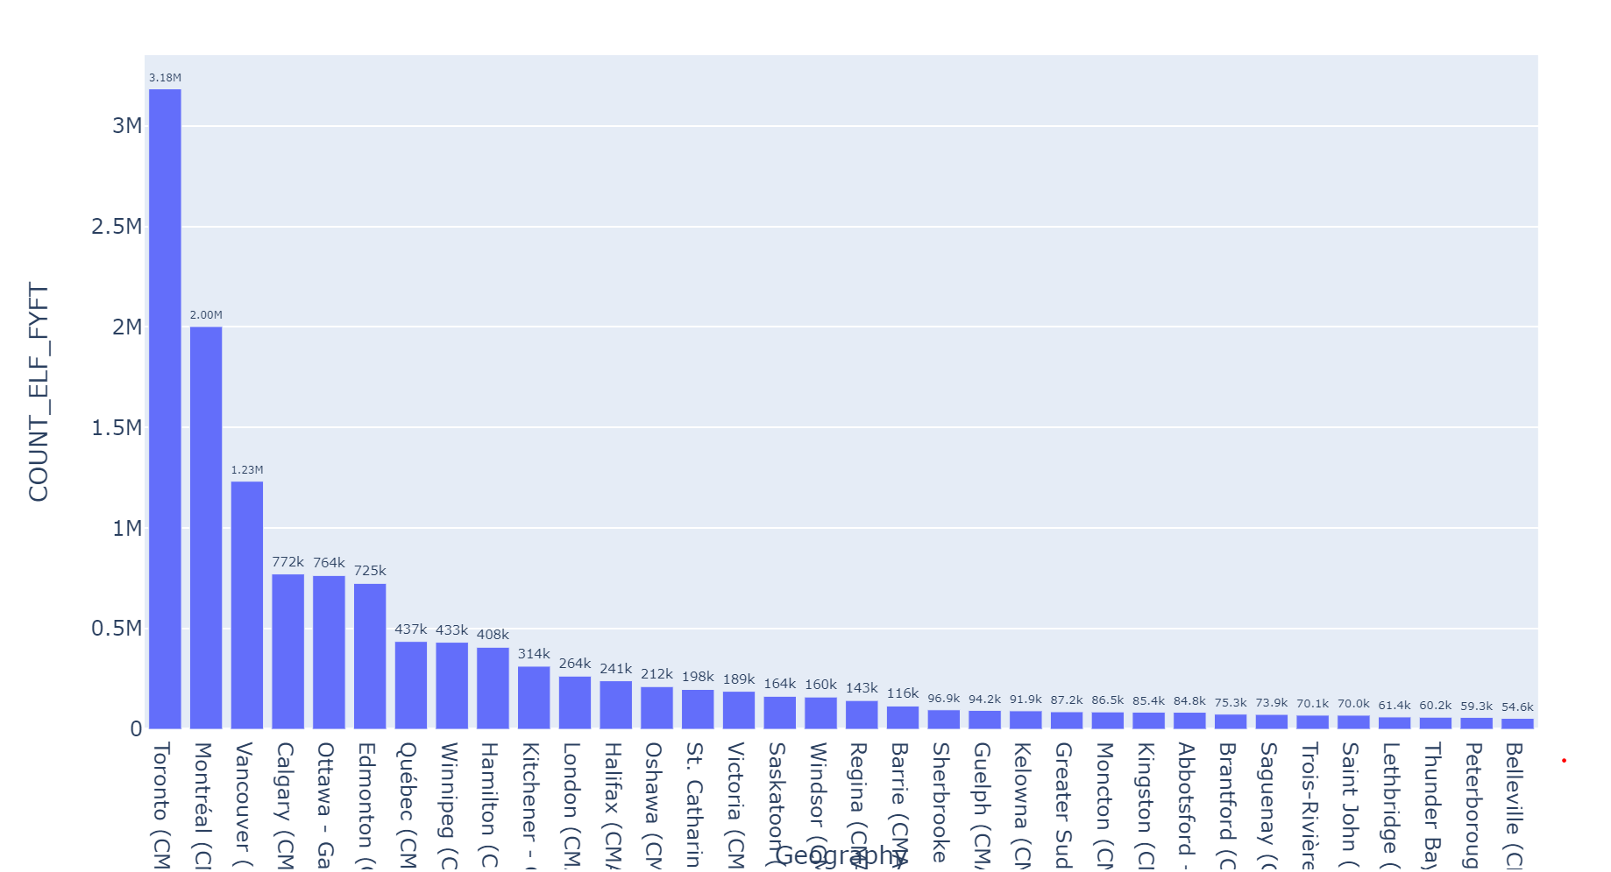
Employment Distribution across Cities
1st – Toronto (3.18M)
2nd – Montreal (2.00M)
3rd – Vancouver (1.23M)

Slide 14
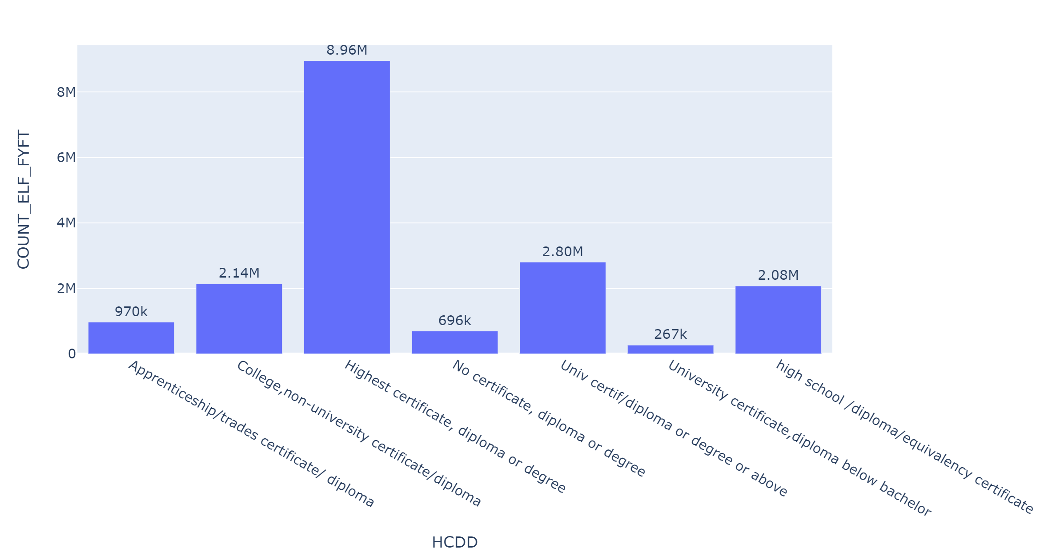
Educational Background of the Employed Labor Force
Highest certificate, diploma or degree holders have the highest share in the job market

Slide 15
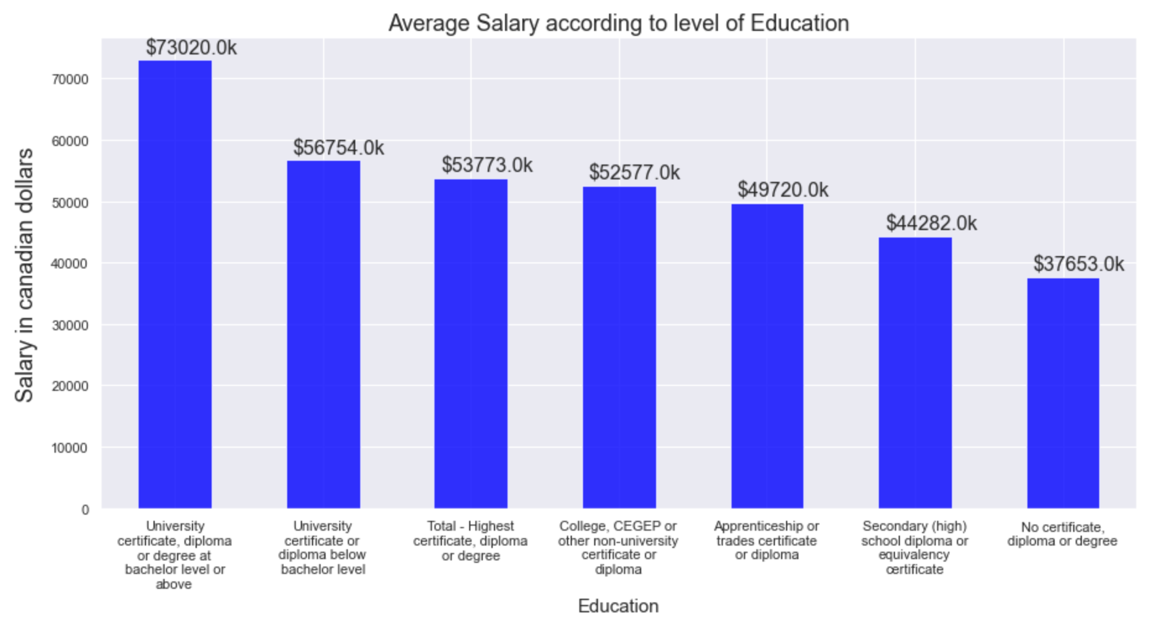
Average Salary by Education Level
Most paid employees have the highest level of education in their respective fields
Salary decreases with decrease in education level

Slide 16
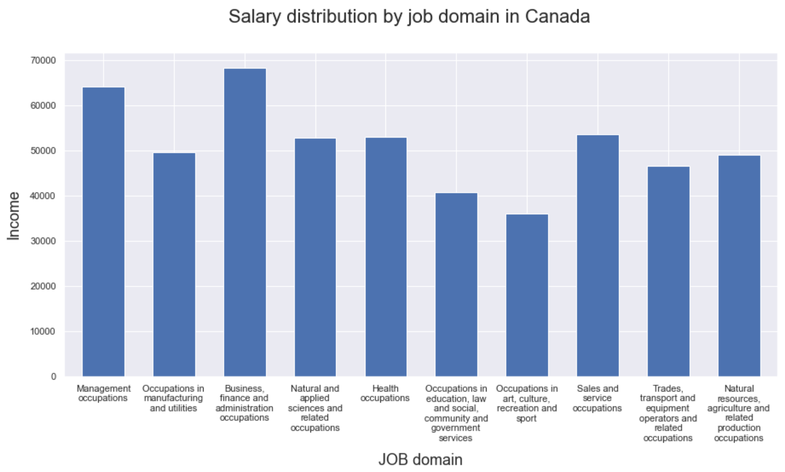
Average Salary by Occupation Class
1st – Business, Finance and Administration
2nd – Management
Least – Art, Culture and Recreation

Slide 17
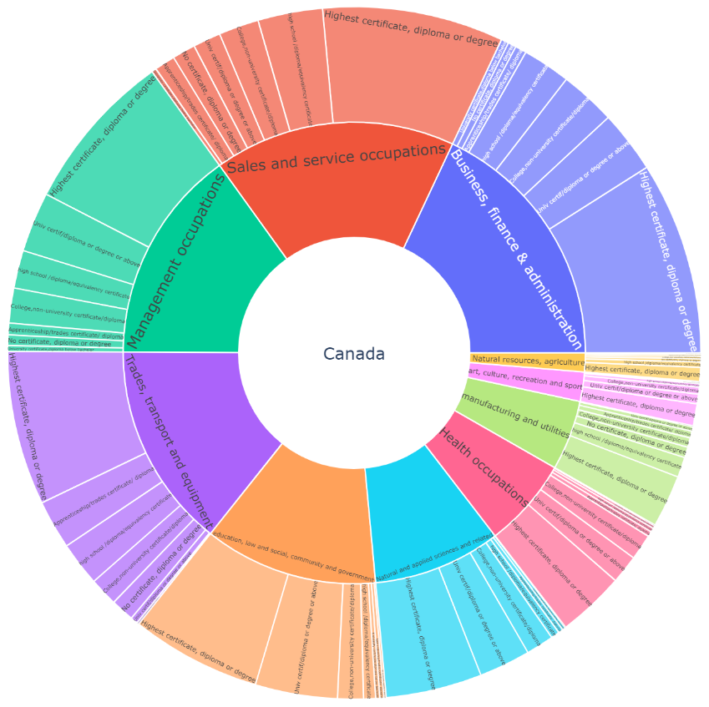
Impact of Education in Job Market
Highest Education Level has the maximum job share across all the Occupation Classes

Slide 18
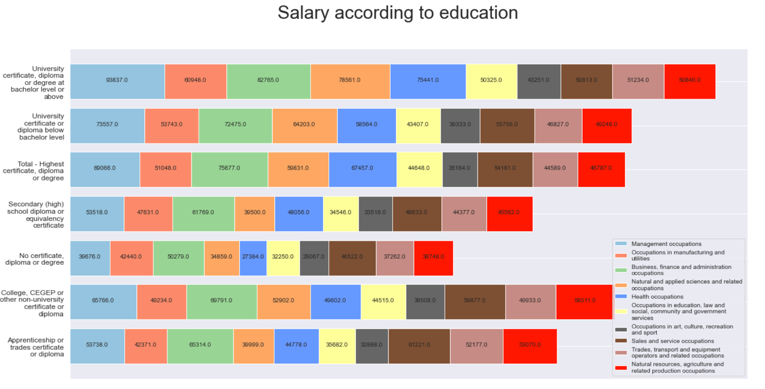
Education vs Salary across all Occupation Classes
Education impacts Salary in all Occupation classes

Slide 19
Let's dig into the Natural and applied science domain

Slide 20
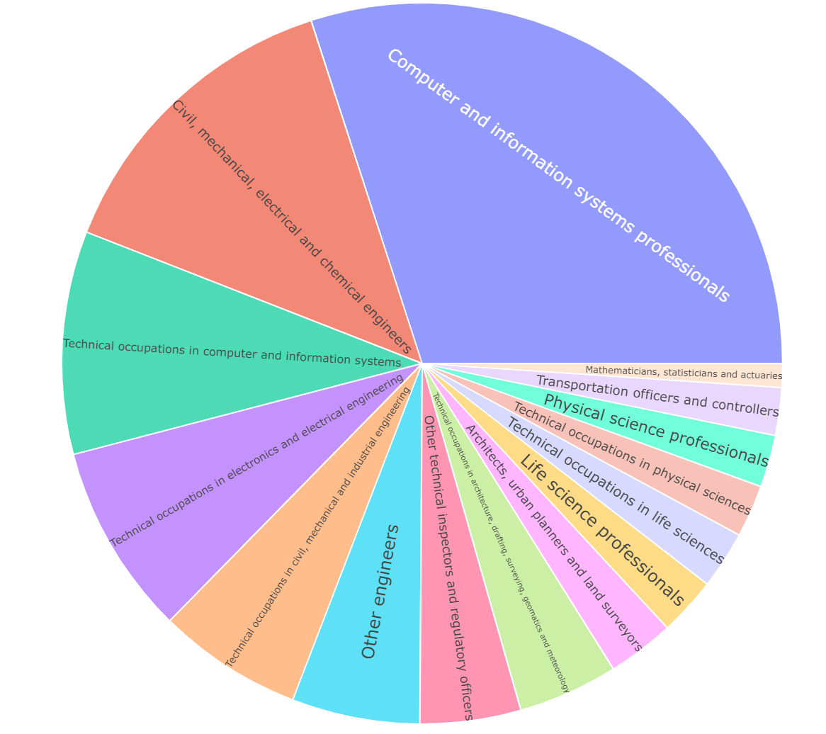
Which is the most employable job type in Natural and Applied Science domain
Computer and Information Systems professionals have the maximum employment
2nd – Civil, Mechanical, Electrical and Chemical Engineering
3rd – Technical occupations in Computer and Information systems

Slide 21
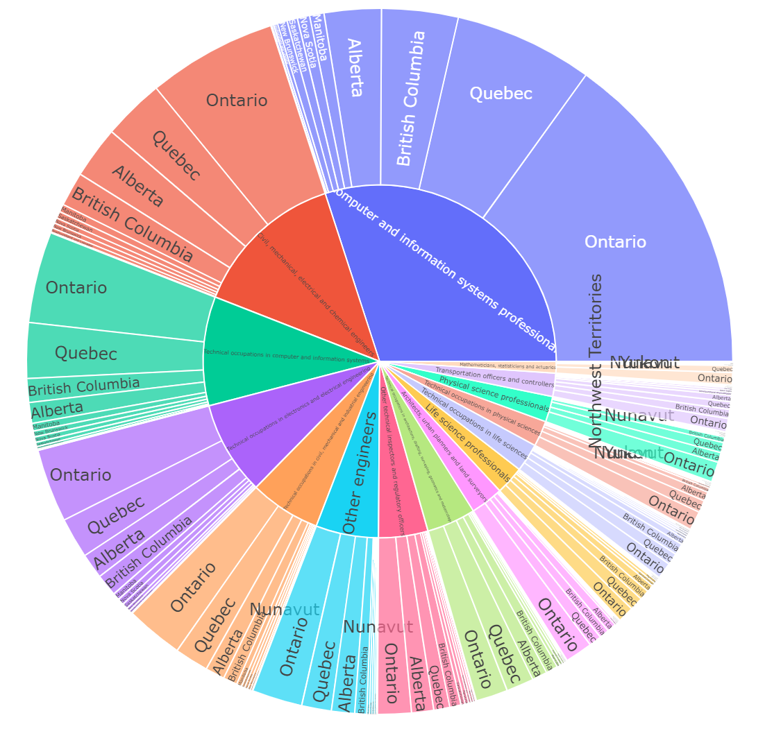
Natural & Applied Science job types share across Canadian Provinces
Computer and Information Systems has the highest share
In each sub-domain on this class the provinces rank as below:
1st - Ontario
2nd – Quebec
3rd – British Columbia

Slide 22
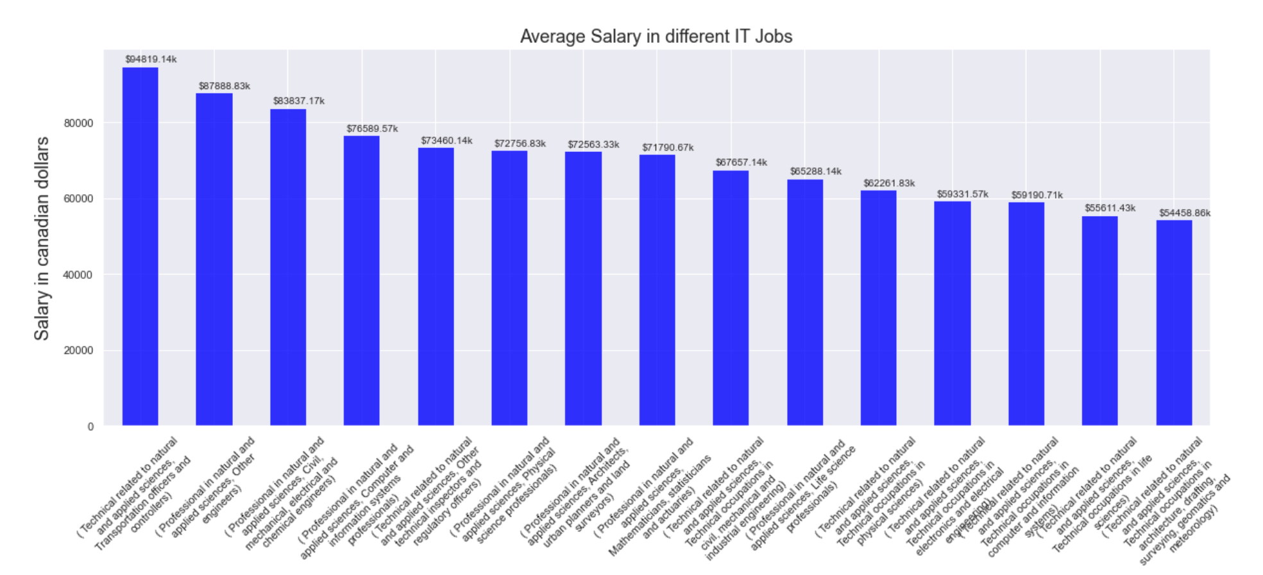
Average Salary in various sub-domains of Natural & Applied Science occupation class
1st – Transportation officers and Controllers
2nd – Civil, Mechanical, Electrical and Chemical engineers
3rd – Computer and IT professionals

Slide 23
Conclusion
Ontario is the largest job market in Canada
Ontario itself produces 40% of total employment in Canada
Management, Manufacturing, and Business and Finance are the market lead
Highest level of education shares the maximum Job market across all Occupation classes
Toronto, Montreal and Vancouver are top 3 employable cities for Computer and IT jobs

Slide 24
Thank You! Questions?

